Slide 1


PYTHON
Lecture 50

Slide 2

Today’s Agenda
Database Programming In Python-I
What Is Data And Database ?
What Is DBMS ?
What Is SQL ?
How To Configure Our System For Database Programming In Python ?

Slide 3
Introduction
Before we learn about Database Programming In Python, let's first understand -
What is Data?
What is Database ?

Slide 4
Introduction
What is Data?
In simple words data can be facts or information.
For example your name, population of a country , names of political parties in your country , today’s temperature etc
A picture , image , file , pdf etc can also be considered data.

Slide 5
Introduction
What is a Database?
A database is a collection of inter-related data or information that is organized so that it can easily be accessed, managed, and updated .
Let's discuss few examples.
Your mobile’s phone book is a database as it stores data pertaining to people like their phone numbers, name and other contact details etc.
Your University uses database to store student details like enrollment no, name , address , academic performance etc
Let's also consider the Facebook. It needs to store, manipulate and present data related to members, their friends, member activities, messages, advertisements and lot more. Here also database is used

Slide 6
How Databases Store The Data ?
Most of the databases store their data in the form of tables
Each table in a database has one or more columns, and each column is assigned a specific data type, such as an integer number, a sequence of characters (for text), or a date.
Each row in the table has a value for each column.

Slide 7
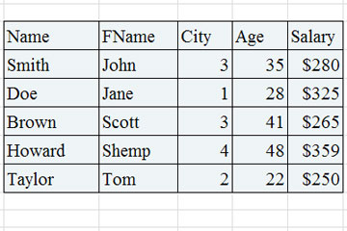
How Databases Store The Data ?

Slide 8
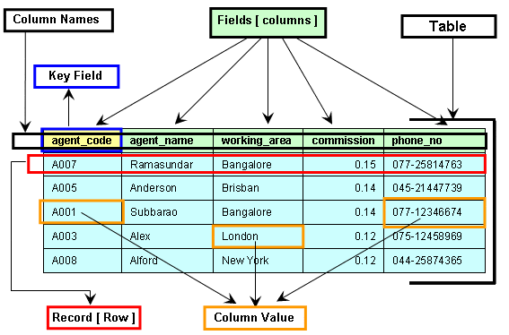
Components Of A Table

Slide 9
What Is A DBMS ?
A DBMS is a program or a software that allows users to perform different operations on a database.
These operations include:
Creating the database/tables
Inserting records into these tables
Selecting records from these tables for displaying
Updating / Deleting the records

Slide 10
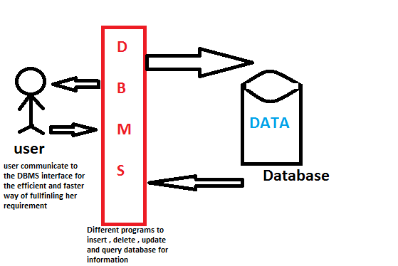
What Is A DBMS ?

Slide 11
Some Popular DBMS
Some of the most popular DBMS are:
Oracle
MySQL
MS SQL Server
SQLite
PostgreSQL
IBM DB2
and many more

Slide 12
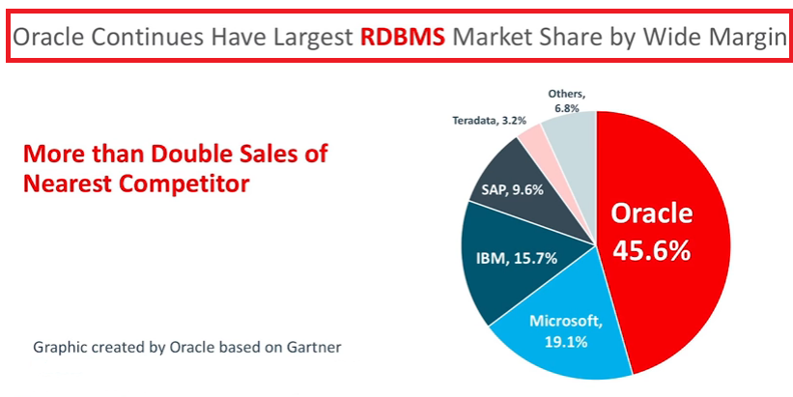
The Market Leader

Slide 13
What Is SQL ?
SQL is an abbreviation for “Structured Query Language”.
It is a language used by EVERY DBMS to interact with the database.
It provides us COMMANDS for inserting data to a database, selecting data from the database and modifying data in the database

Slide 14
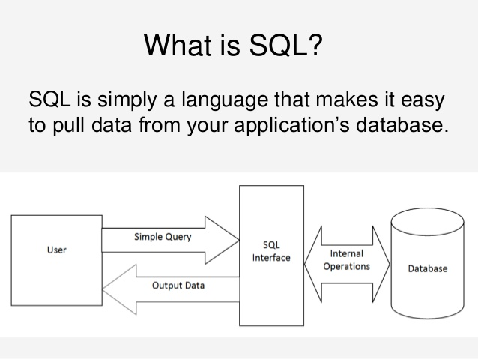
Pictorial View Of SQL

Slide 15
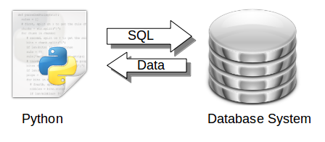
Database Programming In Python
Python is wonderfully able to interact with databases, and this is what we will learn in this chapter.
Advantages:
Platform-independent
Faster and more efficient
Easy to migrate and port database application interfaces

Slide 16
How Python Connects To Database?
Python uses the Python Database API in order to interact with databases.
An API stands for Application Programming Interface.
It is a set of predefined functions , classes and methods given by the language for a particular task and the programmer can use it whenever he wants to perform that task in his code.

Slide 17
How Python Connects To Database?
The Python Database API allows us to handle different database management systems (DBMS) in our Python code.
However the steps at the code level remain altogether same.
That is using the same steps we can connect to Oracle or MySQL or SQLite or any other DBMS

Slide 18
Configuring Our Computer For Database Programming In Python
In order to write database application in Python we must have following softwares/files installed on our computer.
The DBMS with which we will interact . In our case it is Oracle .
The Oracle Instant Client package. ( Reqd only for Oracle)
Setting the path to Oracle Instant Client Package
The Python’s Oracle module called cx_Oracle
We assume that you already have Oracle installed , so in the upcoming slides we will talk about next 3 steps

Slide 19
What Is Oracle Instant Client ?
Oracle Instant Client is a set Oracle libraries that enable programming languages to connect to an Oracle Database
It is used by popular languages and environments including Node.js, Python and PHP, as well as providing access for JDBC, ODBC and Pro*C applications.

Slide 20
Downloading Oracle Instant Client
To download Oracle Instant Client , we will have to visit the following site:
https://oracle.github.io/odpi/doc/installation.html#windows
Scroll down to Windows option and click on 64 bit or 32 bit option as per your computer architecture.

Slide 21
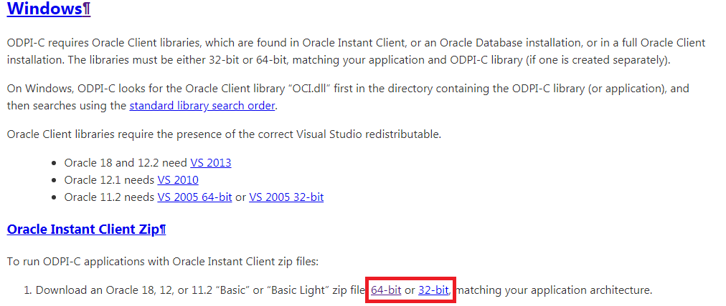
Downloading Oracle Instant Client

Slide 22
Downloading Oracle Instant Client
When we will click on any of these options , we will be redirected to Oracle Instant Client Downloads for Microsoft Windows page.
Here , we will have to click on license agreement and download instantclientbasic-windows.x64 file

Slide 23
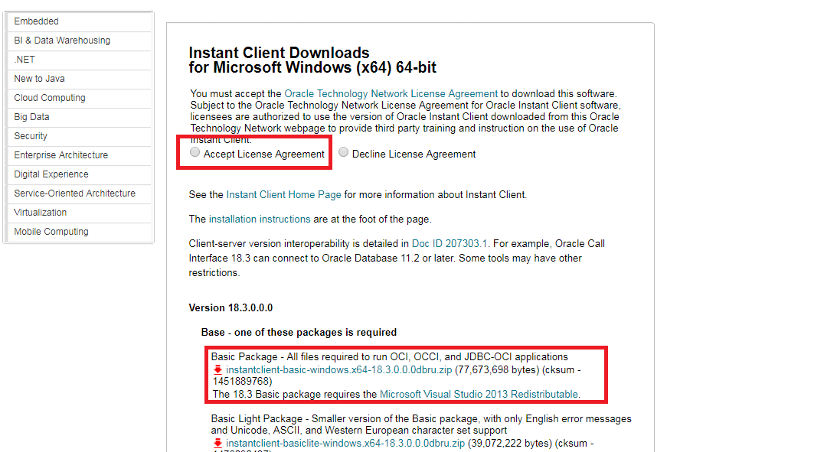
Downloading Oracle Instant Client

Slide 24
Installing Oracle Instant Client
Once we have downloaded this file , we need to unzip it and extract all it’s file in a folder.
For example , I have copied it to d:\oracleinstall\instantclient folder

Slide 25
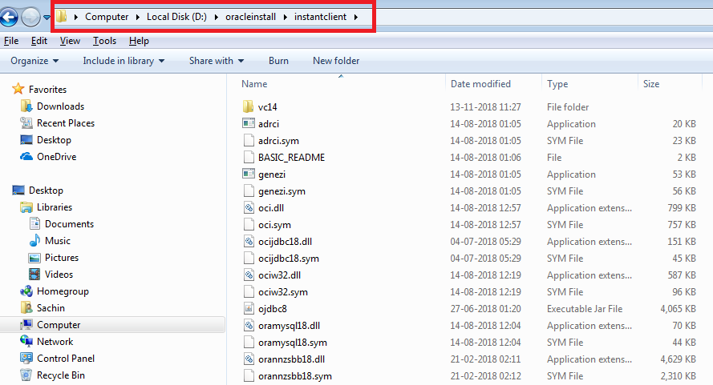
Installing Oracle Instant Client

Slide 26
Setting The Path To Oracle Instant Client
In order for Python to use this library we need to set it’s PATH as follows
For example, on Windows 7, update PATH in Control Panel -> System -> Advanced System Settings -> Advanced -> Environment Variables -> System Variables -> PATH.

Slide 27
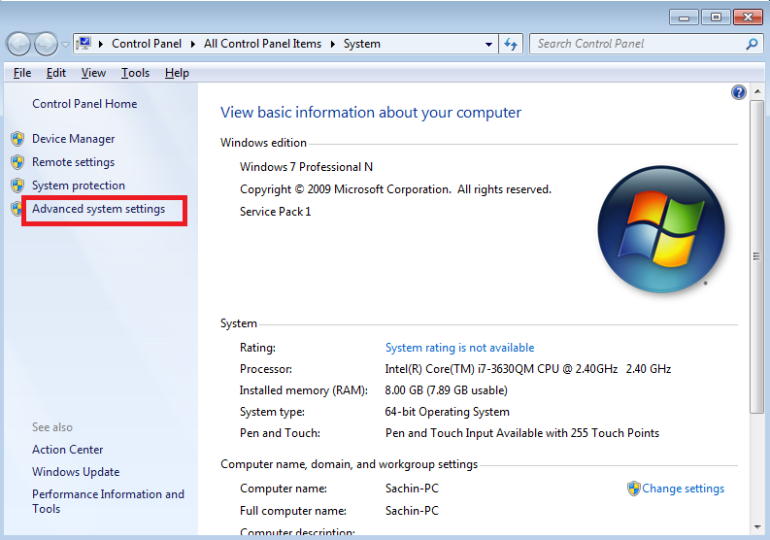
Setting The Path To Oracle Instant Client

Slide 28
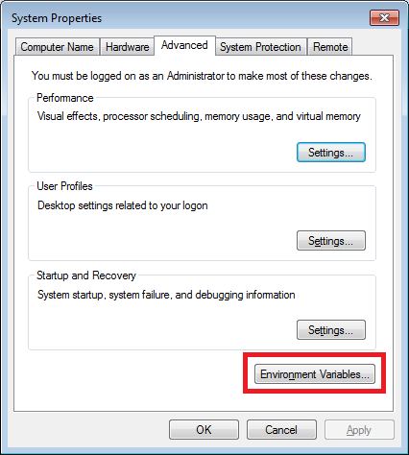
Setting The Path To Oracle Instant Client

Slide 29
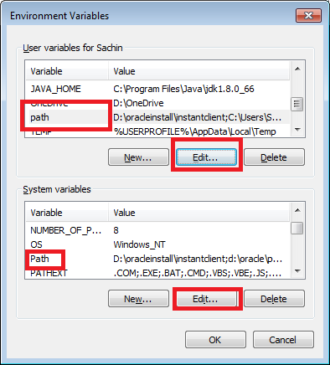
Setting The Path To Oracle Instant Client

Slide 30
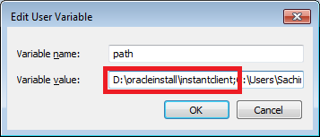
Setting The Path To Oracle Instant Client

Slide 31
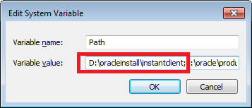
Setting The Path To Oracle Instant Client

Slide 32
The cx_Oracle Module
cx_Oracle is a Python extension module that enables access to Oracle Database.
It conforms to the Python database API 2.0 specification
cx_Oracle 7 has been tested with Python version 2.7, and with versions 3.5 through 3.7.

Slide 33
The pip
PIP is a package manager for Python packages, or modules.
We use it to download those Python packages from the internet which are not a part of our standard Python libraries.
But before using pip , we must set it’s path by setting it’s location in PATH environment variable

Slide 34
Installing cx_Oracle Using pip
Open command prompt and type the following command:
pip install cx_Oracle
Make sure the internet connection is on before running this command
Doing this will automatically download and install cx_Oracle package in our Python environment

Slide 35
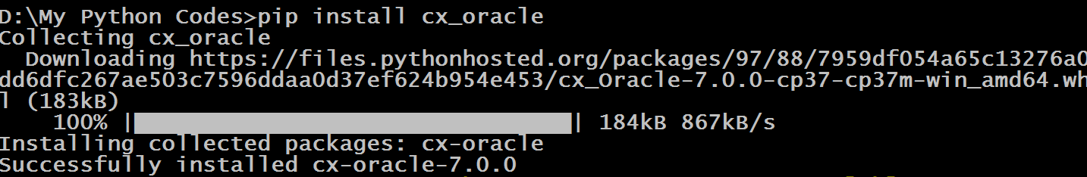
Installing cx_Oracle Using pip

Slide 36
Verifying The Installation
In order to verify whether cx_Oracle has been properly installed follow the steps below:
Open Python shell
Type the command : help(‘modules’).
This will display all the modules currently installed and will show the name of cx_Oracle also

Slide 37
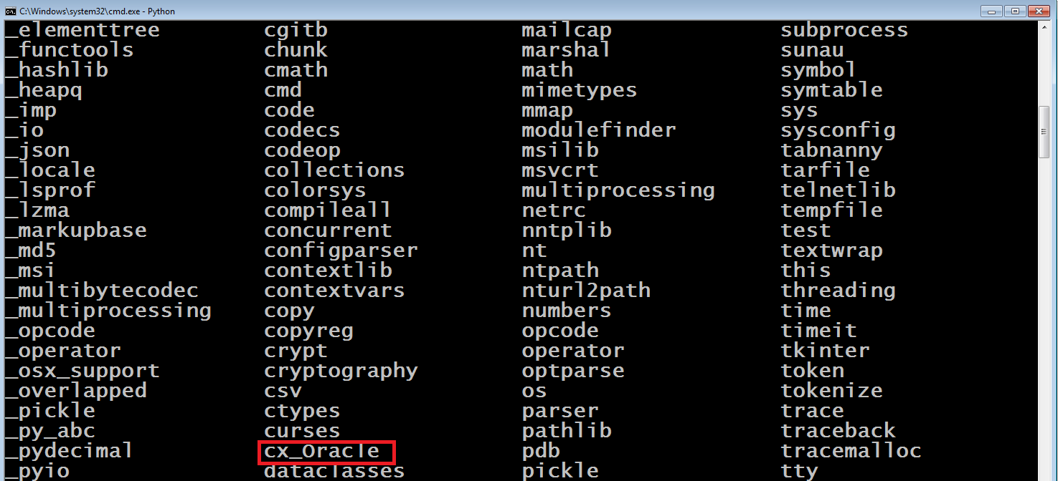
Verifying The Installation

